Slide 1



Slide 2





Which Platform do you use?
Others?

Slide 3




Speaker : Shivji Kumar Jha (Shiv)
Regular Software Developer, Loves Open Source
Working on Databases & Streaming over a decade
Distributed Systems Guy
Employed at Nutanix:
Staff Engineer
Head of “Distributed Data in Cloud”
Previously,
MySQL Replication, Backend microservice, Data Platform
Contributed to MySQL and Pulsar codebases among others.
linkedin.com/in/shivjijha/
youtube.com/@ShivjiKumarJha
slideshare.net/shiv4289

Slide 4
contents
Introduce Apache Pulsar
Some numbers running 4 years in Production
Components under the hood
Read & Write Paths

Slide 5

Introduction

Slide 6

PULSAR IS A PUB-SUB
SUBSCRIBER
SUBSCRIBER
TOPIC
PUBLISHER
SUBSCRIBER

Slide 7
Strong community
600+ contributors
9800+ Slack members
1000+ orgs using Pulsar
2 BLR meetups*

Slide 8
Highlights
Open Source
Apache 2.0 License
Multi-tenancy
Unified Streaming & Queuing
Built for the cloud
Isolation Options
Tiered Storage
Geo Replication
Auto Load Balancing

Slide 9
NUMBERS FROM PRODUCTION

Slide 10
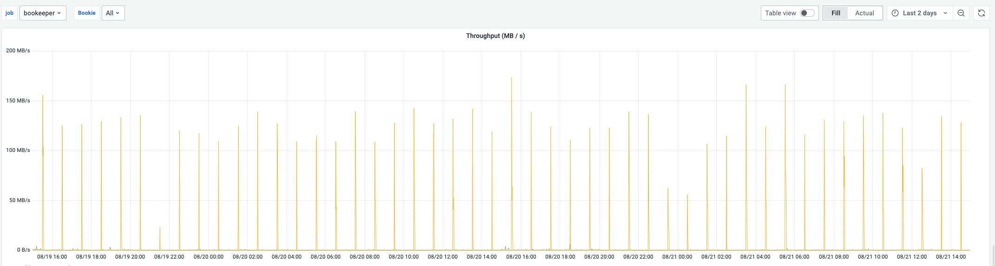
LAST 2 DAYS

Slide 11
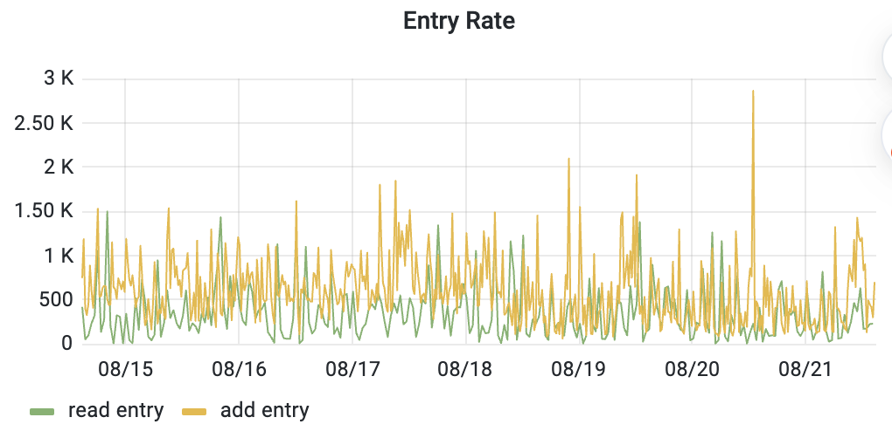
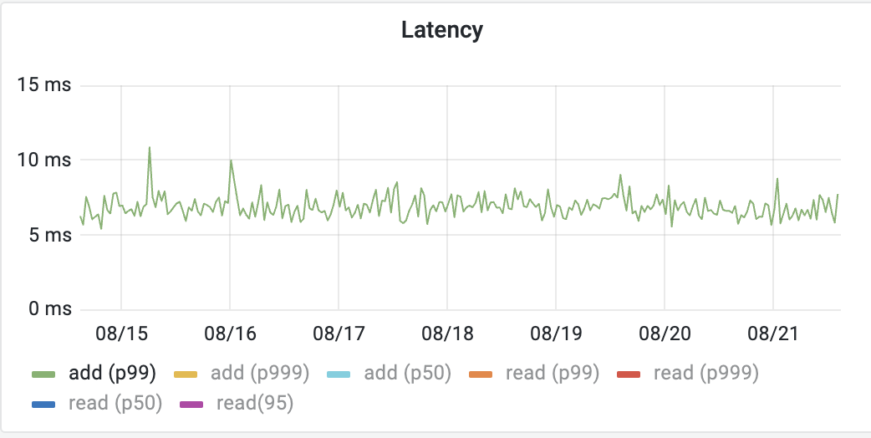
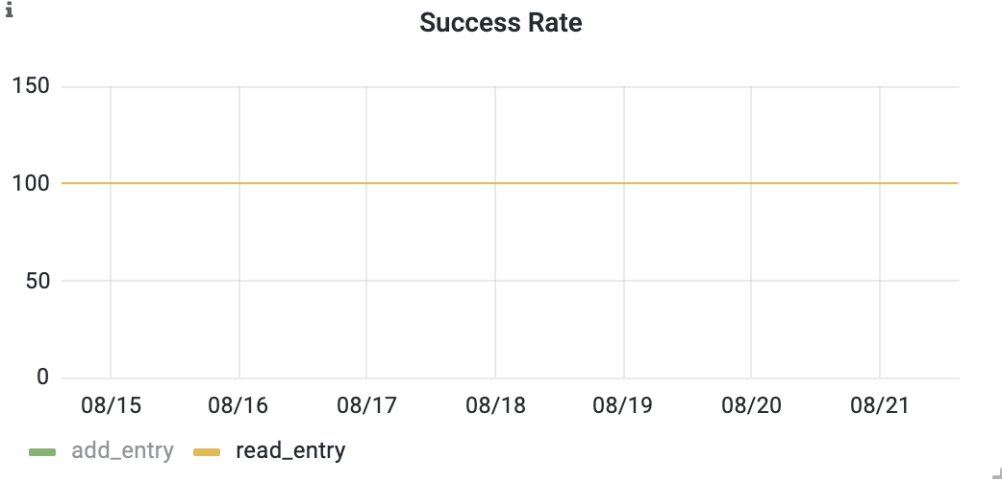
LAST 7 DAYS

Slide 12
ARCHITECTURE

Slide 13
Architecture
APP 1
APP 2

Slide 14
Architecture
PUBLISH
CONSUME
BROKER

Slide 15

Architecture
PUBLISH
CONSUME
BROKER
ZOOKEEPER

Slide 16

Architecture
PUBLISH
CONSUME
PULSAR
BROKER
BOOKKEEPER
ZOOKEEPER

Slide 17
Architecture
PUBLISH
CONSUME
PULSAR
BROKER
BOOKKEEPER
ZOOKEEPER

Slide 18
Architecture
PUBLISH
CONSUME
PULSAR
BROKER (TOPIC CACHE)
BOOKKEEPER (DATA)
ZOOKEEPER (COORDINATION)

Slide 19
READ & WRITE PATH

Slide 20
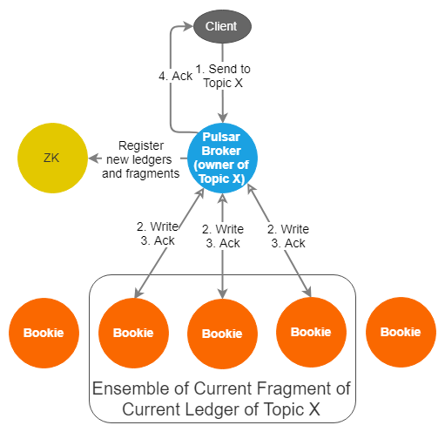
WRITE PATH
https://jack-vanlightly.com/blog/2018/10/2/understanding-how-apache-pulsar-works

Slide 21
Inside One bookkeeper
BOOKKEEPER CLIENT

Slide 22


Inside One bookkeeper
ENTRY <L1 E1>
ENTRY <L1 E2>
ENTRY<L2 EO>
ENTRY<L2 E1>
JOURNAL
ENTRY <L1 E3>
JOURNAL
ENTRY <L2 E2>
BOOKKEEPER CLIENT
ENTRY <L3 EO>
WRITE CACHE
Legend
Synchronous write

Slide 23
Inside One bookkeeper
ENTRY <L1 E1>
ENTRY <L1 E2>
ENTRY<L2 EO>
ENTRY<L2 E1>
JOURNAL
ENTRY <L1 E3>
JOURNAL
ENTRY <L2 E2>
BOOKKEEPER CLIENT
ENTRY <L3 EO>
LEDGER
WRITE CACHE
LEDGER
Legend
Synchronous write
Asynchronous Write

Slide 24
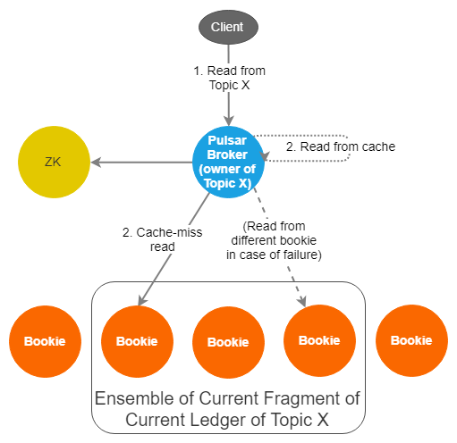
READ PATH
https://jack-vanlightly.com/blog/2018/10/2/understanding-how-apache-pulsar-works

Slide 25

READ (consume) Message
JOURNAL
3. READ CACHE MISS
LEDGER
1. BROKER CACHE HIT
2. BROKER CACHE MISS
APP
(PULSAR CLIENT)
INDEX
READ
CACHE

Slide 26
Highlights Again?
Open Source
Apache 2.0 License
Multi-tenancy
Unified Streaming & Queuing
Built for the cloud
Isolation Options
Tiered Storage
Geo Replication
Auto Load Balancing

Slide 27
References
Understanding how apache pulsar works by Jack Vanlightly
Pulsar architecture performance tuning - StreamNative Blog
How Pulsar Stores Your Data – Pulsar Summit NA 2021
Bookkeeper as a Key Value Store and its use cases – Apache Foundation
Keeping on top of Hybrid Cloud Use Cases – Pulsar Usage at Nutanix
Pulsar vs kafka, NATS and Kinesis – Pulsar Summit Asia 2022
Apache Pulsar Design Choices and Use Case Implications
TGI Pulsar Playlist by Sijie Guo
https://pulsar.apache.org/docs

Slide 28

Questions?
Pulsar Community
https://apache-pulsar.slack.com/
users@pulsar.apache.org
dev@pulsar.apache.org
Contact Speaker
Drop me a message on
linkedin.com/in/shivjijha/
youtube.com/@ShivjiKumarJha
slideshare.net/shiv4289

Slide 29
Appendix

Slide 30



Streaming features
Data processing in order
Ingestion of large amounts of data
Data retention
Handle big catch-up reads
Message queuing features
Add/remove consumers dynamically
Do not block the queue when a consumer is busy or fails to consume one message
Redeliver ‘failed’ messages
Scheduled or delayed delivery
is the best of both worlds!

Slide 31

Pulsar Data Stores : Distribution
Shards (aka namespace Bundles) for load balancing
tenant
namespace
bundle1
bundle2
bundle3
T
O
P
I
C
1
T
O
P
I
C
2
T
O
P
I
C
3
T
O
P
I
C
4
T
O
P
I
C
5
T
O
P
I
C
6

Slide 32
Pulsar Data Stores : Distribution
Shards (aka namespace Bundles) for load balancing
tenant
namespace
topic
bundles
ledgers
cursors
managed ledger

Slide 33
Pulsar Data Stores : Distribution
Shards (aka namespace Bundles) for load balancing
tenant
namespace
topic
bundles
ledgers
cursors
managed ledger

